Slide 1
501: Supervisor Training Series
Module 2: Living the Mission of Child Welfare
Revised 7/2016

Slide 2
The Supervisor Training Series
Module 1: The Preparatory and Beginning Phases of Child Welfare Supervision
Module 2: Living the Mission of Child Welfare
Module 3: The Middle/Work Phase of Supervision
Module 4: Managing Diversity through the Employment Process
Module 5: Endings and Transitions/Managing Staff Retention, Satisfaction, and Separation

Slide 3
Agenda
Day One
  Introduction
  Child Welfare Vision, Mission, Values, and Practice Model
  Child Welfare as an Open System
  Continuous Quality Improvement (CQI)
  Defining Key Outcomes in Serving Families
  Identifying Benchmarks and Indicators

Slide 4
Agenda
Day Two
  Performance Actions and Performance Capacity
  Assessing for Change
  Planning for Change
  Implementing the Change Process
  Monitoring Progress
  Transferring Skills to Practice
  Evaluation and Closure

Slide 5
Learning Objectives
Participants will be able to:
Define organizational mission and outcomes that are consistent with the Adoption and Safe Families Act and the Pennsylvania Child Welfare Practice Model;
Identify the components of an Open System Model;
Describe how Continuous Quality Improvement (CQI) can be achieved using the DAPIMTM framework;

Slide 6
Learning Objectives (continued)
Participants will be able to:
Explore ways to assess and plan work activities of the unit and staff member that will achieve identified outcomes;
Explain how to implement necessary change within the unit; and
Explore ways to monitor work activities to support the achievement of identified outcomes.

Slide 7
Roles of Supervision
Administrative Supervision focuses on those areas of supervision related to the efficient and effective delivery of services. This module stresses the importance of understanding one’s own management style within the context of the agency’s mission and vision and administrative structure and focuses on agency goals and outcomes. It is within this role that the supervisor must always be aware of the supervisor role as an agent of the organization. It becomes the supervisor’s responsibility to support cohesion among the department and collaboration between departments by leading through example.
Educational Supervision
Clinical Supervision

Slide 8
Idea Catcher
Don’t let a good idea get away!
  People remember:
    20% of what they hear
    30% of what they see
    70% of what they say
    90% of what they do

Slide 9
ASFA Provisions
Ensure that child safety is the paramount concern in all child welfare decision-making
Shorten the timeframes for making permanency planning decisions and promote the adoption of children who cannot safely return to their own homes
Focus on the well-being of, and positive results for, children and families and strengthen partnerships between child welfare agencies and other systems to support families at the community level
    Source: Rethinking Child Welfare Practice Under the Adoption and Safe Families Act of 1997: A Resource Guide, by the U. S. Department of Health and Human Services

Slide 10

On the Floor

Slide 11

Let’s Get on the Balcony

Slide 12
Vision
A vision statement describes how the future will look when an organization’s desires and aspirations are realized.
    (American Public Human Services Association, 2011)

Slide 13
Pennsylvania Child Welfare Resource Center’s Vision
“Every child, youth, and family experiences a life rich with positive opportunities, nurturing relationships, and supportive communities.”

Slide 14
Mission
A mission statement describes the particular role an organization plays in realizing that vision. The mission statement must have fit, clarity, and commitment.
  (American Public Human Services Association, 2011)

Slide 15
A Mission Must Have
Fit
Clarity
Commitment

Slide 16
Effective Mission Statements are:
Brief
Broad
Clear
Compelling
Memorable
Real
Cultural

Slide 17
Effective Mission Statements Tell:
Who benefits;
What will be done;
How results will be produced; and
Address the diversity of the population served.

Slide 18
Pennsylvania Child Welfare Resource Center’s Mission Statement
“The Pennsylvania Child Welfare Resource Center is a national leader in advocating for an enhanced quality of life for Pennsylvania’s children, youth, and families.
In partnership with families, communities, public and private agencies, we prepare and support exceptional Child Welfare Professionals and systems through education, research and a commitment to best practice.”

Slide 19

What is the Pennsylvania’s
Child Welfare Practice Model?
✵ Vision & Values 
Linking Ideals
to
Practice
Notes:
Pennsylvania’s Child Welfare Practice Model guides children, youth, families, child welfare representatives and other child and family service partners in working together, providing a consistent basis for decision making; clear expectations of outcomes, shared values and ethics; and a principled way to evaluate their own skills and performance. It helps us to benchmark our achievement, and clearly links the abstract ideals of mission, vision and strategic plans to day-to-day practice.
Tech:
Graphic from MSOffice Online clip art
Alt.tag: flag of the State of Pennsylvania

Slide 20

Pennsylvania’s
Child Welfare Practice Model
Outcomes
Values and Principles
Skills
Notes:
Application of Pennsylvania’s Child Welfare Practice Model shapes and improves our ability to engage and serve the children, youth, and families of our state.
The model delineates the outcomes, values and principles, and essential skills of successful child welfare practice.
Application of Pennsylvania’s Child Welfare Practice Model shapes and improves our ability to engage and serve the children, youth, and families of our state.
The model delineates the outcomes, values and principles, and essential skills of successful child welfare practice.
Tech:
Photo from MSOffice Online clip art
Alt.tag: figure standing on a peak supporting a rainbow

Slide 21

Pennsylvania’s
Child Welfare Practice Model: Outcomes
Safety from abuse and neglect
Permanence
Wellbeing
Support through services
Strengthened families
Skilled and responsive child welfare professionals
Notes:
Audio:
Under Pennsylvania’s Child Welfare Practice Model, team members work together to achieve and maintain six key outcomes:
Safety from abuse and neglect.
Enduring and certain permanence and timely achievement of stability, supports and lifelong connections.
Enhancement of the family’s ability to meet their child/youth’s wellbeing, including physical, emotional, behavioral and educational needs.
Support families within their own homes and communities through comprehensive and accessible services that build on strengths and address individual trauma, needs and concerns.
Strengthened families that successfully sustain positive changes that lead to safe, nurturing and healthy environments, and
Skilled and responsive child welfare professionals, who perform with a shared sense of accountability for assuring child-centered, family-focused policy, best practice and positive outcomes.

Slide 22

Pennsylvania’s
Child Welfare Practice Model :
Values and Principles
Children, Youth, Families
Community
Honesty
Cultural Awareness and Responsiveness
Respect
Teaming
Organizational Excellence
Notes:
Pennsylvania’s Child Welfare Practice Model cites and describes values and principles in seven areas, enumerating and carrying into practice our belief in:
Children, Youth and Families,
Community,
Honesty,
Cultural awareness and responsiveness,
Respect,
Teaming, and
Organizational excellence.
Tech:
Photo from MSOffice Online clip art
Alt.tag: handshake

Slide 23

Pennsylvania’s
Child Welfare Practice Model :
Skills
Engaging
Teaming
Assessing and Understanding
Planning
Implementing
Monitoring and Adjusting
Notes:
The Practice Model also describes six skills essential to achieving our desired outcomes:
Engaging, or establishing and maintaining relationships;
Teaming, or collaborating with others, including the family, in a unified effort throughout all phases of the change process;
Assessing and Understanding, or gathering and sharing information to fully inform the team, and using that information to keep the team’s understanding current and comprehensive;
Planning, or developing strategies and supports to achieve goals;
Implementing, or actively performing roles to produce sustainable results; and
Monitoring and Adjusting, or continuously evaluating effectiveness and modifying until goals are achieved
Tech:
Photo from MSOffice Online clip art
Alt.tag: team members talking together

Slide 24
For More Information on Pennsylvania’s Child Welfare Practice Model…
http://www.pacwrc.pitt.edu/PracticeModel.htm

Slide 25
What is a System?
“A group of interacting, interrelated, and interdependent components that form a complex and unified whole.”
(pegasus.com, 2011)

Slide 26
Characteristics of All Systems
Every system has a purpose within a larger system;
All of a system's parts must be present for the system to carry out its purpose optimally;
A system's parts must be arranged in a specific way for the system to carry out its purpose;
Systems change in response to feedback; and
Systems maintain their stability by making adjustments based on feedback.
(Pegasus.com, 2011)

Slide 28
Continuous Quality Improvement (CQI)
The ongoing process by which an agency makes decisions and evaluates its progress.
The National Resource Center for Organizational Improvement and Casey Family Programs

Slide 29
The Purpose of Continuous Quality Improvement (CQI)
The purpose of CQI is to consistently gather information from a variety of sources that can help to evaluate the quality of services delivered, inform decision making related to program and agency improvements, and assist in the development of a plan for improvement.

Slide 30

What Does DAPIM™ Mean?
D: Define
A: Assess
P: Plan
I: Implement
M: Monitor

Slide 31
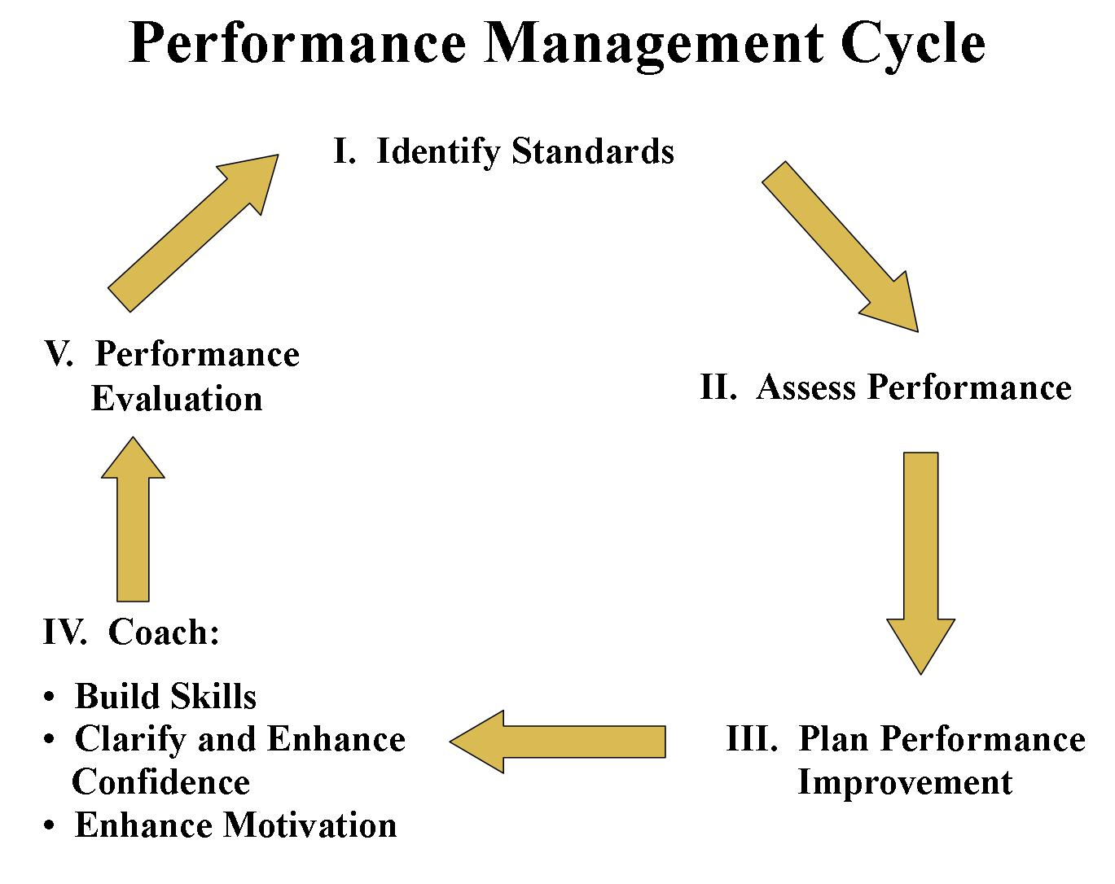

Slide 32
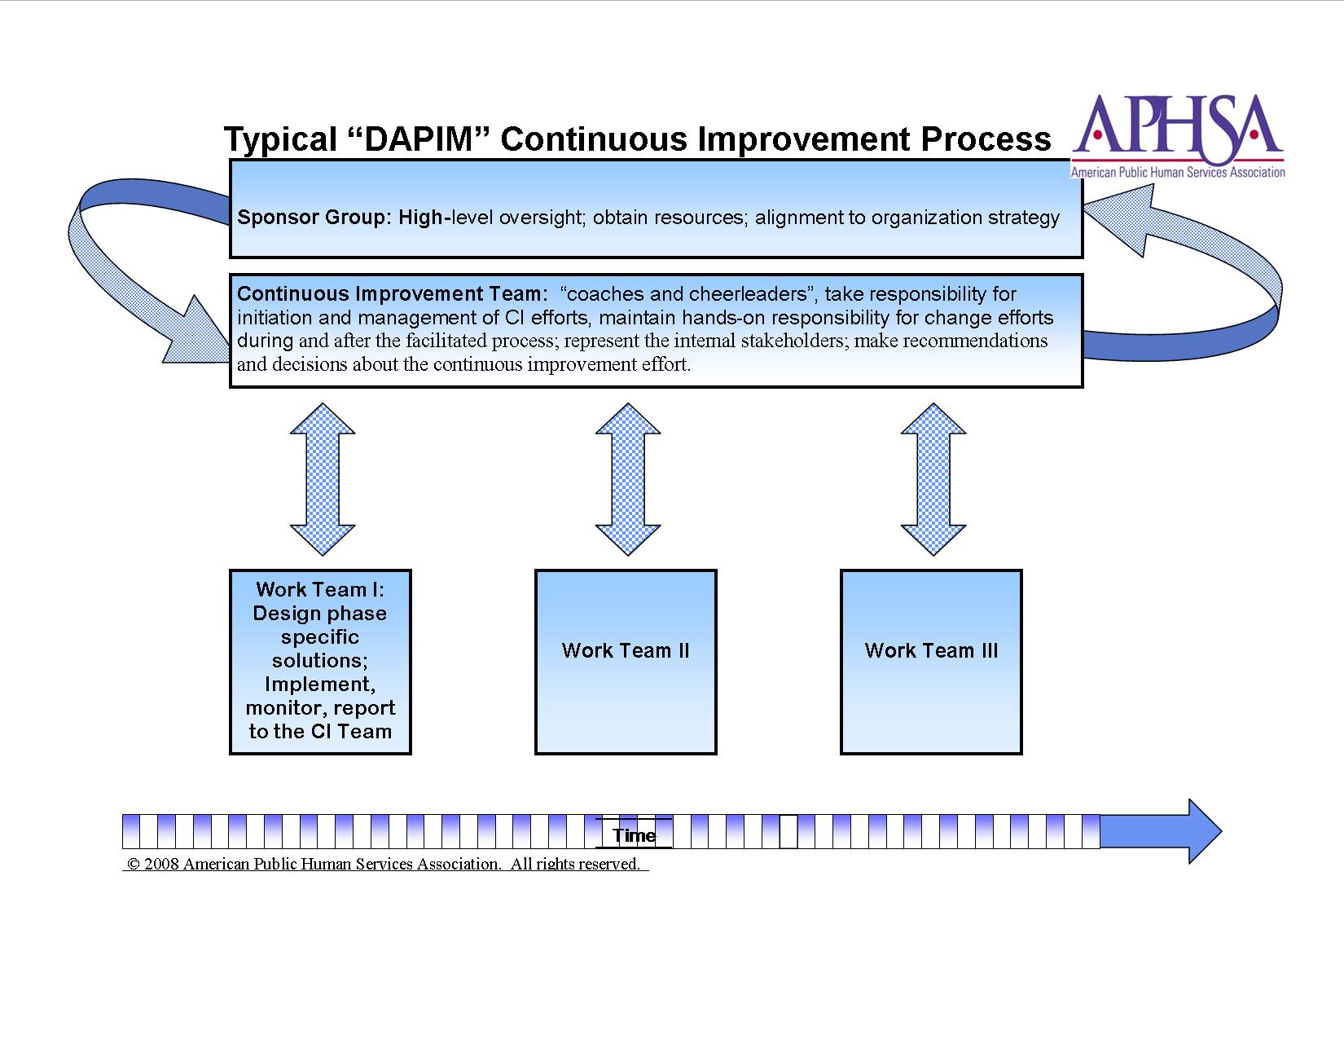

Typical “DAPIM” Continuous Improvement Process
Sponsor Group: High-level overnight; obtain resources; alignment to org. strategy
Continuous Improvement Team: “coaches and cheerleaders”, take responsibility for initiation and management of CI efforts, maintain hands-on responsibility for change efforts during and after the facilitated process; represent the internal stakeholders; make recommendations and decisions about the continuous improvement effort.
Work Team I:
Design phase specific solutions; Implement, monitor, report to the CI Team
Work Team II
Work Team III
Time
© 2008 American Public Human Services Association. All rights reserved.

Slide 33
DAPIMTM (Define)
Define the Desired Future State.
  What do you want to improve?
  If the problem were solved, what would you see in your agency?
  How would you define success?

Slide 34
DAPIMTM (Assess)
Assess strategy, inputs (resources), performance capacity, performance activities, outputs, outcomes, and feedback from the environment.

Slide 35
DAPIMTM (Bridge to Planning)
Bridging assessment and planning work involves group input, brainstorming, and dialogue to determine:
  Findings: Strengths and Gaps
  Priority Needs
  Root Causes
  General Remedies

Slide 36
DAPIMTM (Bridge to Planning)
Why are work teams important?
They create buy-in. Staff at all levels have a chance to participate in creating something that would have an impact on themselves and others.

Slide 37
DAPIMTM (Plan)
  Identifies both rapid (quick wins), mid term improvements, and long-term improvements;
  Involves the County Improvement Plan that drives the Needs Based Plan and Budget.
  Includes capacity planning; and
  Includes communication planning.

Slide 38
DAPIMTM (Implement)
Implement those plans in detail.
  Work teams continue;
  Action plans;
  Capacity building turns into capacity management; and
  Communication management.

Slide 39
DAPIMTM (Monitor)
Monitor progress and impact for accountability and ongoing adjustment.

Slide 40
DAPIMTM (Monitor) (continued)
Monitoring completes the flywheel.
Monitoring uncovers new areas for continuous improvement.
The flywheel starts again resulting in Continuous Quality Improvement.

Slide 41
“We must become the change we want to see”
Mahatma Ghandi

Slide 42
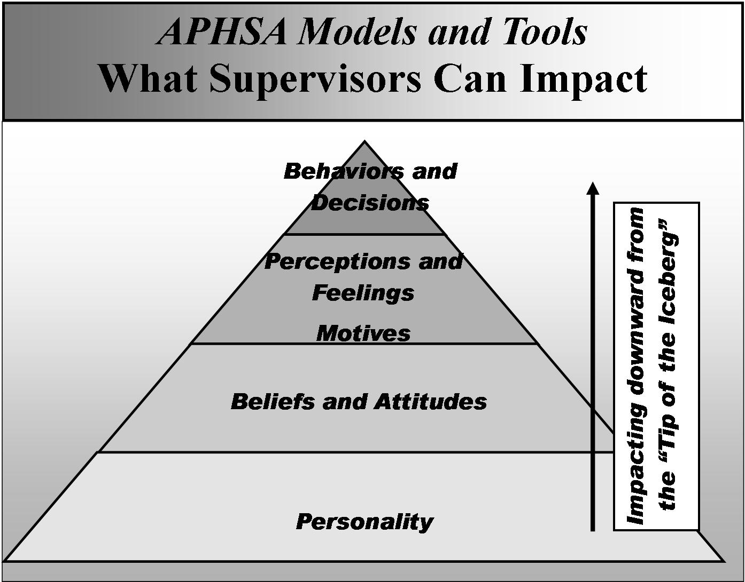


Slide 43
Define the Desired Future State
  What do you want to improve?
  If the problem were solved, what would you see in your agency?
  How would you define success?

Slide 44
Outcomes are:
Mission-critical
Specific
Measurable
Observable
Behavior-oriented
Results-oriented (rather than stating an output)

Slide 45
Benchmarks & Indicators
Benchmarks and indicators helps us to measure progress toward mission-critical results.

Slide 46
What’s the Difference?
Indicators describe what we are measuring to gauge performance or progress toward the outcome.
Benchmarks are the measurements for which we aim that demonstrate that progress is being made toward the outcome.
  numbers 3 out of 10
  increases 10% ⬆
  decreases 5% ⬇
  stability 90% ➔

Slide 47
Baseline
1st measurement of the indicator

Slide 48
Effective Benchmarks and Indicators are:
Specific
Observable
Measurable
Mission-Critical
Culturally Competent
Clear and Reasonable

Slide 49
Agenda
Day One
  Introduction
  Child Welfare Vision, Mission, Values, and Practice Model
  Child Welfare As An Open System
  Continuous Quality Improvement (CQI)
  Defining Key Outcomes In Serving Families
  Identifying Benchmarks And Indicators

Slide 50
Agenda
Day Two
  Performance Actions And Performance Capacity
  Assessing For Change
  Planning For Change
  Implementing The Change Process
  Monitoring Progress
  Transferring Skills To Practice
  Evaluation And Closure

Slide 51
Performance Capacity
Workforce capacity- a unit or department’s combined knowledge and skills.
Functional capacity- Use of strategic support functions
Trust-
  Perceived level of physical and emotional safety within the work place.
  Partnerships, cliques, or subcultures

Slide 52
Competencies
Skills and Knowledge

Slide 53
What is a Skill?
A specific behavior that the worker uses in the helping process.
(Shulman, 1999)

Slide 54
Skills
Engaging
Teaming
Assessing and Understanding
Planning
Implementing
Monitoring and Adjusting

Slide 55
Which Skill is Responsible?
Monitoring and Adjusting?
Assessing and Understanding?
Engaging?

Slide 56
Knowledge
“What do my workers need to know to do a specific job?”
“What knowledge does this worker need?”

Slide 57
Competency Tasks
Identify the following for which a child welfare professional needs to meet your assigned QSR indicator:
  Skills
  Knowledge

Slide 58
Bridge to Planning
Prioritizing gaps
Root cause analysis
APHSA, 2009

Slide 59
Root Cause Analysis
What isn’t working and why specifically is that?
APHSA, 2009

Slide 60
Three Types of Remedies
Recommendations;
Decisions or commitments; or
Team activities.
APHSA, 2009

Slide 61
Remedies for My Unit
Remedy: Quick Win? Mid-Term Improvement? Long-Term Improvement? Source: APHSA 2009 | Is the remedy in my control? Yes? No? → ↓ | Recommendation: Make it to person or group that has control.
 | Does the remedy require new processes or tools? Yes? No? → ↓ | Decision/ Commitment: Move to planning.
 | Create workgroup to design new product or process → | Team Activity: Move to planning.

Slide 62
Planning
Organizing the change plan;
Capacity building; and
Communication planning.

Slide 63
Capacity Building Questions
What do we need to execute our initiatives and hit output goals?
What inputs do we have? (resources, staff, materials, space, money)
What state or condition are our resources in now?
How adaptable/flexible are our resources?
What staff developmental needs do we have?
APHSA, 2009

Slide 64
The Purposes of Communication Planning
Demonstrate explicitly a commitment to improving client outcomes and services over time;
Build unit credibility with outside staff;
Remind the work team of commitments made;

Slide 65
The Purposes of Communication Planning (cont’d)
Get everyone on the same page about improvement work to be done, how it will be rolled out over time, how different initiatives are connected, and why they matter;
Track accountability and monitor progress while reinforcing a culture of accountability, data-driven assessment, follow-through, and ongoing adjustment;
AND

Slide 66
The Most Important Purpose of Communication Planning is to:
Minimize rumors, fear, and resistance of the change process that inevitably will surface.

Slide 67
Principles of Effective Feedback
Feedback should be:
  Balanced
  Specific
  Objective
  Appropriate
  Understandable
  Participative
  Comparable
  Actionable
  Sufficient
  Hierarchical

Slide 68
Tasks of Implementation
Chartering work teams
Capacity management
Communication management
APHSA, 2009

Slide 69
Typical “DAPIM” Continuous Improvement Process
Sponsor Group: High-level overnight; obtain resources; alignment to org. strategy
Continuous Improvement Team: “coaches and cheerleaders”, take responsibility for initiation and management of CI efforts, maintain hands-on responsibility for change efforts during and after the facilitated process; represent the internal stakeholders; make recommendations and decisions about the continuous improvement effort.
Work Team I:
Design phase specific solutions; Implement, monitor, report to the CI Team
Work Team II
Work Team III
Time
© 2008 American Public Human Services Association. All rights reserved.

Slide 70
Implementation (Capacity Management)
Capacity
Planning
Capacity
Management
APHSA, 2009

Slide 71
Implementation: Communication Management
Communication
Planning
Communication
Management
APHSA, 2009

Slide 72
Steps in the Change Process
(1) unfreezing the equilibrium,
(2) moving into a state of disequilibrium, and
(3) freezing at a new quasi-stationary equilibrium. The third step is still quasi because it too is a stop along the way.
Sanborn, 1991

Slide 73
Implications of Change
Expressions of ambivalence, defensiveness, and resistance are normal.
Persons must feel safe and supported throughout the change process.
Ambivalence about change may make it necessary for the supervisor to exercise more power to facilitate the process of growth.
Shulman, 2011

Slide 74
A Simple Model for Managing Change
(American Productivity and Quality Center, 1993)

Slide 75
Managing Change
What was the vision?
Who was impacted?
What skills were needed by staff ?
What were the benefits to staff, clients, and the community for supporting and implementing the improvement?
What resources were needed?
Who was involved in developing the action plan?

Slide 76
Who Moved My Cheese?
How could each of the character’s behavior be explained?
    Hem
    Haw
    Scurry
    Sniff
Imagine you were the leader in charge of the cheese. What feedback are the characters giving you through their behaviors?

Slide 77
The Purposes of Monitoring
Holds those accountable for creating the necessary change.
Measures success.
Gathers data needed to keep the DAPIM™ flywheel in motion.

Slide 78
Three Types of Monitoring Activities
Lessons Learned
Implementation Review
Impact Review
APHSA, 2009

Slide 79
Lessons Learned
Critical conversations that address new and emerging questions and can drive innovations within an agency.
Example: After Action Review
  What went well?
  What didn’t go well?
  What should be different next time?

Slide 80
Implementation Review
Measurement accomplishments and milestones from Improvement Plan.
“Did we do what we said we’d do.”
The most basic form of monitoring.
Regularly through leadership team meetings, unit meetings, and supervisory conferences.

Slide 81
Impact Review
A higher level technique and measures impact on organizational capacity or client outcomes.

Slide 82
Examples of Impact Reviews
Federal Child and Family Services
Pennsylvania QSRs
County QSRs
?
Monitors states’ outcomes
Monitors counties’ outcomes
Monitors departments’ outcomes
Monitors staff’s outcomes

Slide 83
Heraclitus’s Famous Words
“The only constant is change.”

